Slide 1
LIMITED SCOPE SERVICES: A CORE PART OF 100% ACCESS
Jessica Bednarz, Director of Innovation and Training at the Chicago Bar Foundation
Marquita Green Family Law Low Bono Director at Jacksonville Area Legal Aid, Inc.
Dave Aarons, Founder & CEO of Unbundled Attorney
Katherine Alteneder, Executive Director SRLN, Moderator

Slide 2
UNBUNDLING ------ SIGH

Slide 3
OBSTACLES IN LAWYER’S MINDS
More guidance/clarity concerning ethical obligations for unbundled matters
Sample limited-scope agreements
1
5
Nothing. Unbundling is just not in my future
More guidance/clarity concerning malpractice exposure for unbundled matters
2
6
Information to better understand fee structures for unbundled legal services
More guidance/clarity concerning court procedures for unbundled matters
3
7
Programs to connect you with prospective clients interested in unbundled legal services
Opportunities to network with lawyers who unbundle
4
8
ABA Survey 2017

Slide 4
THEORY OF CHANGE: LAWYERS WILL REPRESENT PEOPLE IN HEARINGS AND THERE WILL BE NO MORE SRLS
X

Slide 5
THEORY OF CHANGE: LAWYERS WILL PROVIDE PEOPLE THE LEGAL HELP THEY NEED ✅

Slide 6
PIPELINES
FLOW
A B

Slide 7
TECHNOLOGY FACILITATES FLOW

Slide 8
JACKSONVILLE AREA LEGAL AID PROJECT
Family Law Assistance at Reduced Expense (FLARE)
Internal Pilot = March 2018; Soft Launch = July 2018
Panel of local, private bar attorneys
Ineligible grantees of legal aid
https://www.jaxlegalaid.org/reducedfee/flare/
Limited scope and/or full representation options
Dissolution of Marriage forms portal by Florida Justice Technology Center

Slide 9
CHICAGO BAR FOUNDATION PROJECTS
Chicago Bar Foundation Justice Entrepreneurs Project
JEP June 2013
60+ attorneys in the JEP network
Lawyer-Matching platform -Community Lawyer
Chicago Bar Association/Chicago Bar Foundation Limited Scope Panels
Limited scope/unbundled family law and landlord/tenant.
Launched Fall 2017
https://chicagobarfoundation.org/limitedscope/#faq.

Slide 10
MARKET BASED SOLUTIONS
Unbundled Attorney – Lead Generation with a Purpose
We empower attorneys by
Delivering educated, exclusive client leads
Educating them on how to profitably offer unbundled legal services
Leverage technology to streamline the delivery of services
Connecting to a community of unbundled attorneys nationwide
We empower the public by
Promoting awareness of unbundled services
Educating them on how they work and what they cost
Connecting them with unbundled attorneys in their area

Slide 11
BREAKOUT
Client Source/Pipeline Provider
Legal aid Court annexed programs
Bar Association Legal Aid
Court - self-help center Lawyer referral panels
Court - clerk’s office Private attorneys
Court – courtroom Incubator programs
Court – other Law school clinics
Internet On-line tools
Non-profits Other?
Other?

Slide 12
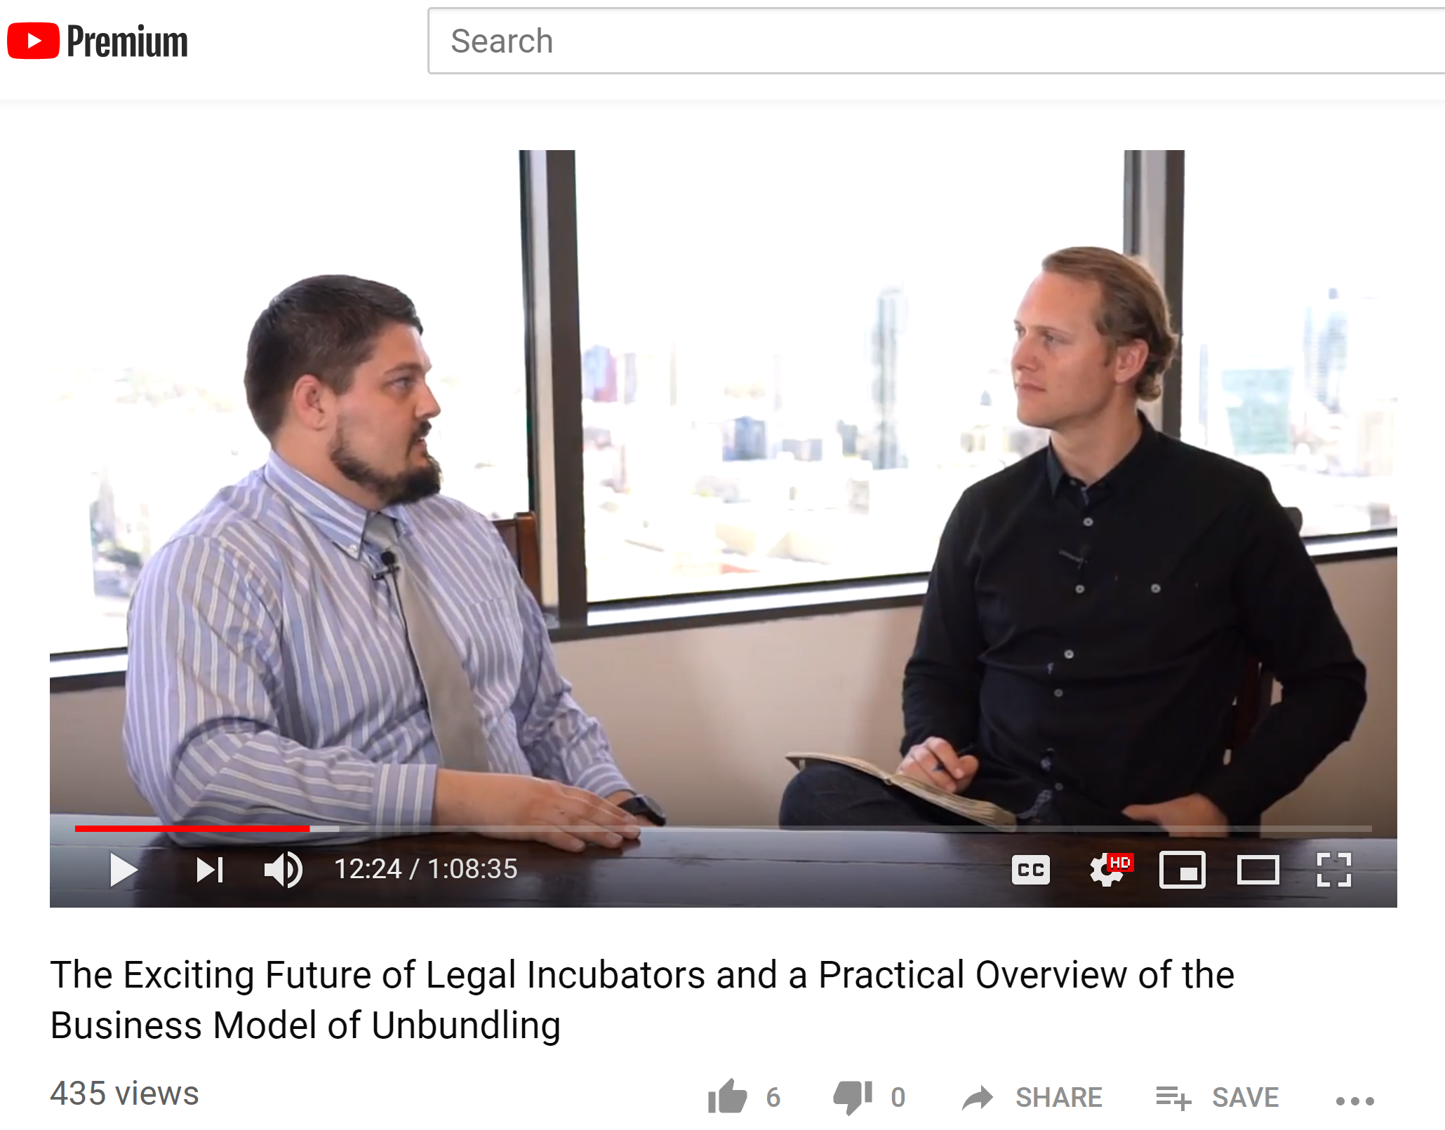
Unbundled Attorney Podcast:
How Private Attorneys Are Delivering Unbundled Services
https://youtube.com/unbundledattorney

Slide 13
THANK YOU
Resources at SRLN Unbundling https://www.srln.org/taxonomy/term/174
Jessica Bednarz, jbednarz@chicagobar.org
Marquita Green, marquita.green@jaxlegalaid.org
Dave Aarons, dave@unbundledattorney.com
Katherine Alteneder, Katherine@srln.org

