Slide 1
Remote usability testing and user feedback
Mathias Burton
Notes:
A little context about myself

Slide 2
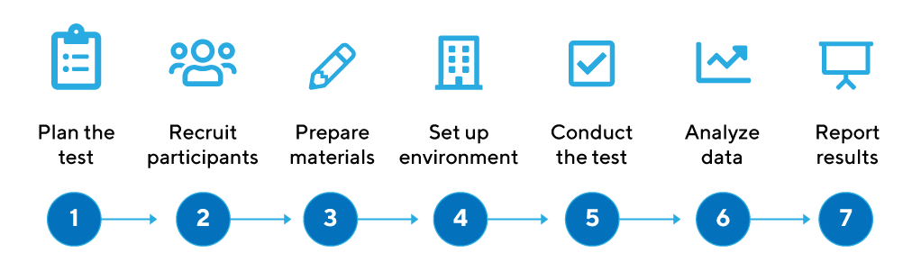
Basic Framework in Testing
--
Notes:
Usability Testing been around a long time
Standard practice in the human-centered design process
At it’s nuts and bolts it’s a small evaluative loop
Doesn’t require a lot of people - Nielsen famoue for noting 5 participants, 80% of issues)

Slide 3





Example of my process
--
Interviewing & Note-Taking
Post-Session Surveys
Recruiting & Scheduling
Pre-session Screener
Analysis of Findings
Insights Gathering
Consolidated Recommendations
Documented Process
Comparison with other insights
Synthesis of all findings
Notes:
Most of our time was in planning and organizing the usability test, starting with recruiting participants.
The city of Seattle helped us schedule with residents via social media.
To keep pace, we supplemented with residents we knew with project timing but keeping within the bounds of our screening questions.
We distributed responsibilities of moderating and note-taking during interviews, and discussed our findings to gather insights.
We consolidated those findings here and in the report we’re finishing for next week. The whole process went for about 8 weeks.

Slide 4
Variables in Usability
Different ways to accomplish usability
Remote
In-Person
Structure
Moderated
Unmoderated
Task-Based
Understanding-Based
Style
Individual
Group
Compensation
Influence
Value
Within-Subject
Between-Subject
Notes:
Different tests lead to different results
Structure: Remote removes context, but does provide a digital one (mostly focusing in remote here)
Unmoderated better for things like benchmarking
Groups change outcome significantly but can stimulate new lines of inquiries

Slide 5

Danger!
Where to be careful trading off
Selection of evaluators
Budgeting time for recruiting
Incentives...
Team Politics
INternational testing
Team Involvement
Notes:
Recruiting - “The quality of the resulting data depends on the degree to which the people you are studying reflect the target group of users.”
-- Selection: Requires a screener, too broad or narrow, unnecessarily complex (Open up school schedule on usertesting.com prevented false testers)
-- Time: “Good recruiting takes time.” < Or at least a good strategy (Open Seattle Guerilla testing)
-- Incentives: “For some recruits, you must expect to pay significant incentives” (RefWorks = $100, Socrata = non-monetary efforts)
Team Politics: “make sure that her objectivity is trusted and that she has enough standing with the team”
International: Trouble speaking the language (City of Seattle / Equity in Usability)
Team Involvement: Can prevent commitment to the outcomes (I reco at least 1 non-designer)

Slide 6





Environments
Different Environments carry differing quality and benefites
Remote
Moderated
Group

Slide 7




Recruiting
Different Environments to consider
Recruiting on the web removes responsibility but isn’t free.
Range of costs can be $10 - $60 / person
Product User Groups
Gather repeating participants interested in changing the systems they’re using
Opt-in Community Recruiting
Establish recruiting pool as a network (maybe in partnership with SRLN) to build contacts
Unmoderated
Service Loop Recruiting
Integrate a rapid test within or between your services to capture in-situ feedback
Long-term recruiting approaches build up a operational flow that makes future testing powerful, but comes with operational cost

Slide 8
Test Design
--
Time on Task
Self-Discovery
Task Success
Speed to value
5-30 participants
3-7 participants
Task-Based
Understanding-Based
Script-oriented
Discussion Guide
10-30 minutes
30-90 minutes
Compensation
Influence

Slide 9
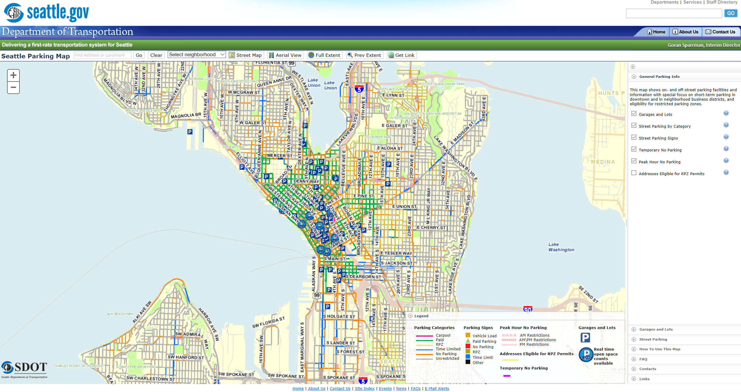
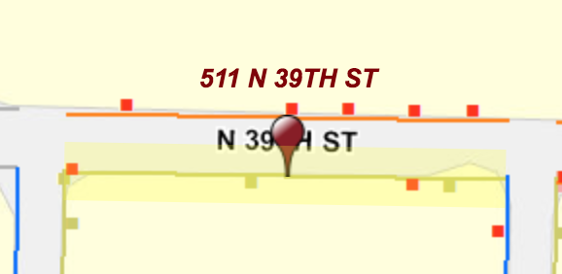
Users did not notice that the RPZ parking data was turned off by default
4 out of 7 users did not turn on this layer, and were unable to confidently identify whether or not their home was eligible for an RPZ permit without prompting
Users also mistook destination highlighting for the RPZ color

Slide 10

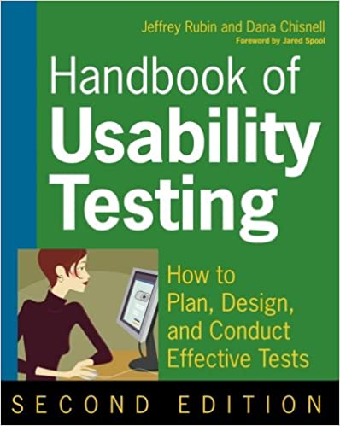
Going further
--
Notes:
-

