Slide 1

Self-Represented Litigation Network
2021 Forms Competition
SRLN Forms & Technology Working Group
May 12, 2021
2:00 pm - 3:00 pm eastern

Slide 2
Welcome our new Co-Chair
Angie VanSchoick
Court Administrator for Breckinridge Municipal Court
NACM board member
Notes:
Introducing a new Co-Chair for the working group, Angie VanSchoick. Angie is the court administrator for Breckinridge Municipal Court and a NACM board member. By training she is a social worker and brings a true commitment to ATJ and improving systems. She'll be joining Jane in driving our working group activities forward, and we're excited for you all to meet.

Slide 3
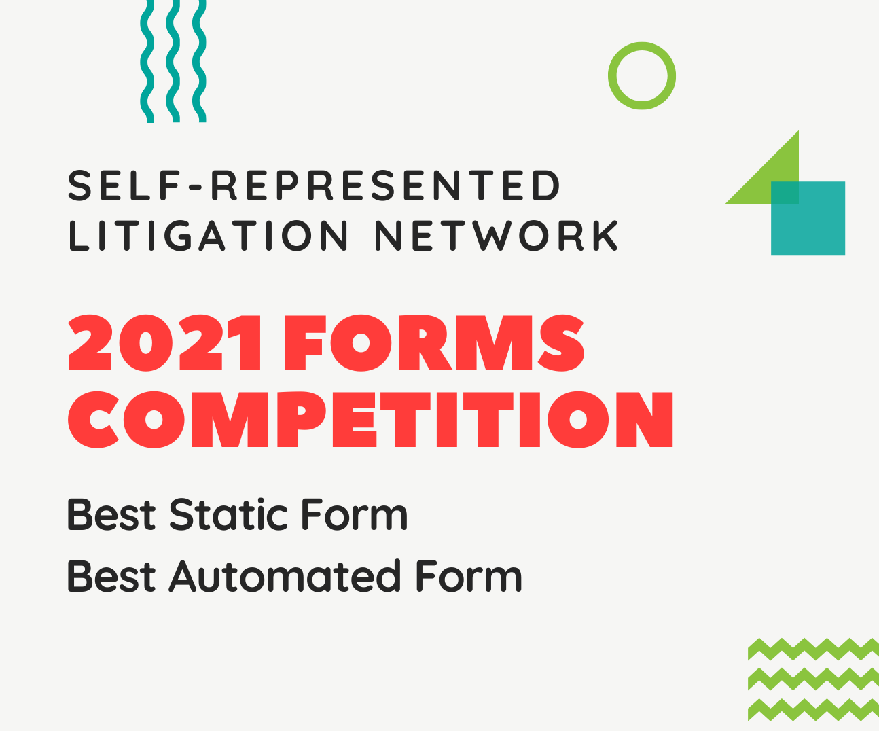
2021 Forms Competition

Slide 4
A special thank you to our judges!
Sonja Ebron, Courtroom5
Mathias Burton, Tyler Technologies
Maria Mindlin, Transcend Translations
Charleston Carter, Trial Court Administrator for the Judicial Branch of North Carolina (NACM Director)
Angie VanSchoick, Court Administrator Town of Breckenridge (NACM Director)

Slide 5
2021 Forms Competition
Obstacles & Solutions identified by contestants
Resistance to change
Communicating about resources
Publishing challenges
Engaging stakeholders
Legitimizing forms
Longterm planning
Capacity and time
Language limitations
Involve stakeholders
Involve users
Balance simple instructions & pragmatic navigation
Marketing
Collecting use data
Skills development
Outsource translation
Notes:
Reasons forms were selected –
Frequency of use
Packets - comprehensive guides
Intentionally designed (updated based on commonly asked questions/observed errors)
Informed - to fill a gap and respond to user needs
Testing Solutions - to address observed barriers to settlement
Interactive features: advanced logic; samples; previews;
Obstacles identified –
Make small changes over time; Resistance to change
A form was around a long time and didn’t change much, it was difficult to introduce a change that would respond to user needs
Publishing forms is not as simple as posting online, you need to communicate with professionals not informed about court forms
A form needed to go through a vetting process to post on a government site, but reviewers didn’t know why the court forms were needed.
Interest in user friendly forms
Engaging stakeholders to legitimize forms
Co-designed to discuss common defenses
Educating staff: Bench bar meetings to inform stakeholders
Respond to concerns about ambiguity
Awareness of the resources
Develop strategy to increase awareness: 1) involved the ATJ working group; 2) change court rules; 3) integrate form project with existing initiatives
Enabling tooltips enhanced value of existing forms
Packet: Balance between pragmatic navigation and simplifying forms
Subject matter experts to review work
Capacity to create and develop
Existing platforms (websites) create difficulty in providing resources/forms
Long planning: part of longterm strategic plan
Limit physical need to be in court
Marketing campaigns
Community outreach
Picked up new skills

Slide 6
2021 Forms Competition
User Testing
Keeping forms up to date
Involve existing ATJ working groups
Observable data
Survey data
Collect comments over time
Engage staff
Dedicated forms manager
Integrating updates with workflows
Tracking rule changes
Establishing a committee/working group
Engage subject matter experts

Slide 7
2021 Forms Competition
Languages
Case Types
General Civil
Administrative
Fee Waivers
Probate
Name & Gender Marker Change
Expungement
Workers Compensation
Family Law
Domestic Violence
Consumer Debt
Landlord-Tenant
Guardianship
Spanish
Somali
Vietnamese
Portuguese
Chinese
Notes:
8 General Civil
Administrative Law
Fee Waivers
Probate
LGBT Name & Gender Marker Change
Expungement
Workers Compensation
4 Family Law (divorce, custody, child support)
2 Consumer Debt
1 Guardianship
2 Domestic Violence
2 Landlord-Tenant

Slide 8
Case types by category
19 Contestants
8 Static Forms
11 Automated Forms
5 General Civil
Administrative Law
Fee Waivers
Probate
Name & Gender Marker Change
1 Family Law (divorce, custody, child support)
1 Consumer Debt
1 Guardianship
3 General Civil
Expungement
Workers Compensation
3 Family Law (divorce, custody, child support)
2 Domestic Violence
2 Landlord-Tenant
1 Consumer Debt

Slide 9
Congratulations! Automated Form
11 Automated Forms
UMKC School of Law, Bloch Law Library
Domestic Violence

Slide 10
Congratulations! Static Form
8 Static Forms
Minnesota State Court Administrator's Office
Guardianship

Slide 11
Well-done everyone!
8 Static Forms
11 Automated Forms
Baltimore County Circuit Court Law Library
Minnesota State Court Administrator's Office
Alaska Court System
Colorado Courts
State of Nebraska Administrative Office of the Courts and Probation
Indiana Legal Services
King County Law Library
Ottawa County Legal Self-Help Center
Community Legal Services of Mid Florida
Michigan Legal Help Program
Suffolk Law School
Ohio Legal Help
Lagniappe Law Lab
Tennessee Alliance for Legal Services
Illinois Legal Aid Online
Northwest Justice Project
UMKC School of Law, Bloch Law Library
Legal Aid Center of Southern Nevada
Iowa Judicial Branch

