Slide 1
Access to Justice & Self-Represented Litigants : An overview for circuit clerks, law librarians, and other court staff

Slide 2
Today’s Discussion
Self-Represented Litigants
Changing demographics and needs
“Safe Harbor” Policy
Understanding legal information and advice
Resources and Referrals
Connecting litigants with other resources

Slide 3
The role of the court is changing
Source: Administrative Office of the Illinois Courts Annual Report (http://www.illinoiscourts.gov/SupremeCourt/AnnReport.asp)
Notes:
Data from the AOIC shows a steady decline in civil case filings over the last few years, despite bump from foreclosure filings in 2007-2010.
This is constant across all judicial circuits and most case types (with a few exceptions, notably small claims).

Slide 5
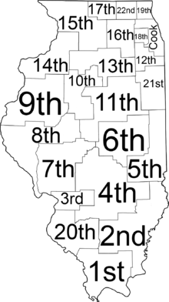
Court users are also changing
SRLs In Every County
93 counties report 50% or more of civil cases have at least one SRL
SRLs In Every Courthouse
73% of circuit clerks see SRLs daily
SRLs In Ever Courtroom
69% of civil judges see SRLs daily
Most SRLs Don't Want To Be SRLs
75% of SRLs want an attorney but cannot find or afford one
Notes:
In 2015, AOIC started tracking data on the number of self-represented litigants in civil cases. First year of data shows that in most counties, self-represented litigants outnumber attorneys.
Case types with the highest % of SRLs are:
Dissolution
Municipal
Small Claims
Orders of Protection
Family
Nationally, about 60% of civil litigants are SRL. IL is not an outlier.

Slide 6
Barriers to justice: Challenges faced by self-Represented litigants

Slide 7
Why Are litigants Self-Represented?
SRL By Choice
SRL By Circumstance
Maintain control over case
Could afford an attorney but choose to save the money
Simple case that can be easily resolved
Can't afford an attorney
Can't find or access an attorney
Age or disability
Lack of information
No local attorneys
Conflicts of interest
Limited English proficiency
Don't know that a problem is legal
Don't understand the scope and consequences of a legal problem
Notes:
Many reasons litigants forego hiring an attorney. National studies show about 75% of SRLs would have preferred an attorney but couldn't find or afford one.
Increasingly large numbers of SRLs are middle class and priced out of high attorney hourly rates.
Other than money, litigants may not use attorneys because of disability, language, or comprehension barriers.

Slide 8
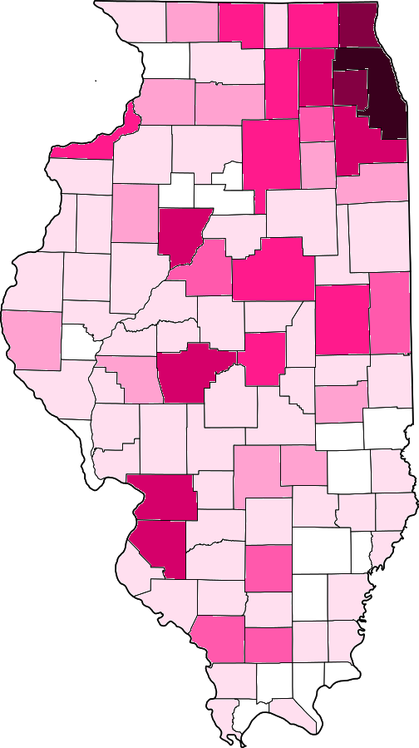
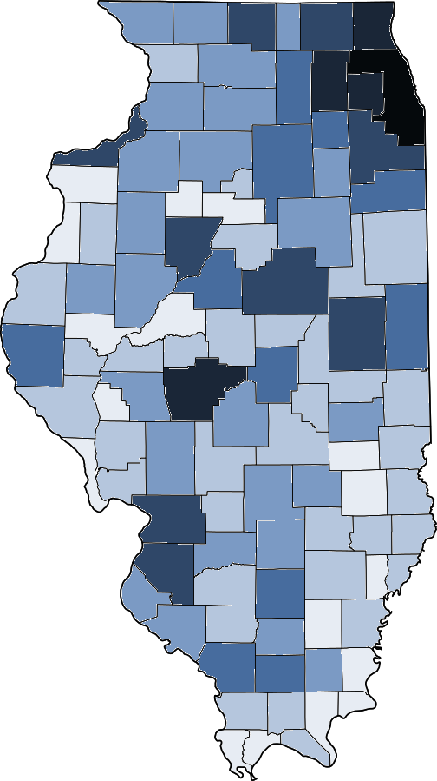
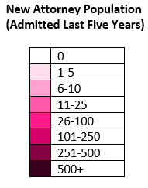
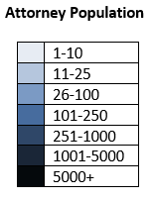
Barriers to justice – AttorneyS
Outside Chicago, the attorney population is aging and becoming more concentrated
16 counties have admitted zero new attorneys since 2012, and 52 counties admitted fewer than five
52 counties, covering more than half of the state, have 25 or fewer attorneys
Notes:
In large parts of our state, there aren't enough (or any) attorneys. New attorneys are disproportionately clustered in the Chicago metro area.
A litigant looking for an attorney, may simply not find anyone available to take the case.

Slide 9
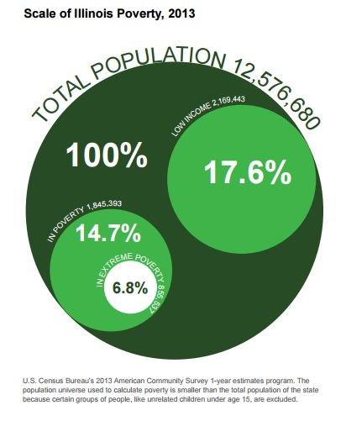
Barriers to justice
Notes:
These maps show additional barriers faced by SRLs. Many communities in the state are aging and litigants may have trouble traveling to court. In some communities, large numbers of the population don't have access to a court and no easy way to get to court or an attorney's office.

Slide 10
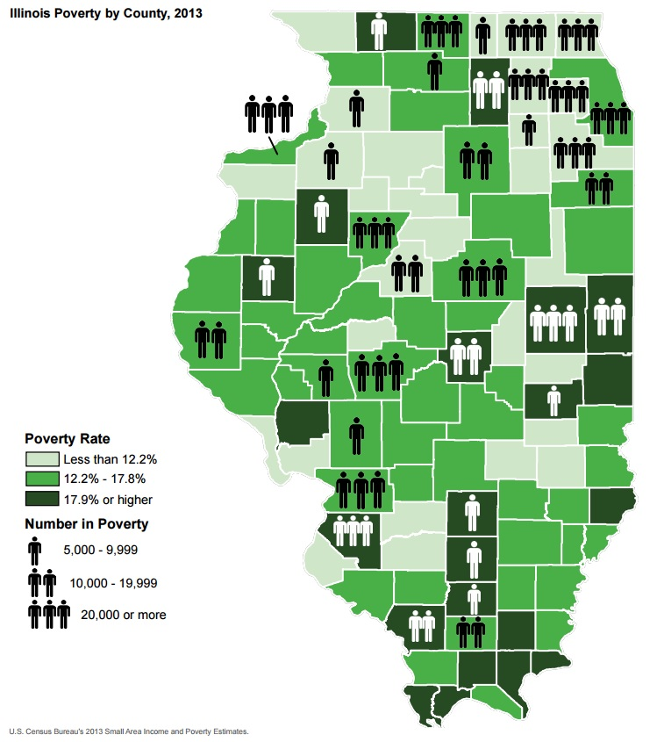
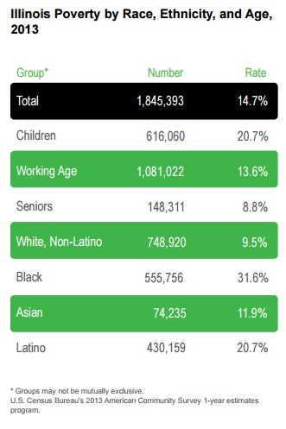
Notes:
Poverty rates by race and region. Poverty is not unique to any one area of the state or any one demographic group.

Slide 11
Defining poverty
Family Size | 100% FPL | 125% FPL
1 | $11,880 | $14,850
2 | $16,020 | $20,025
3 | $20,160 | $25,200
4 | $24,300 | $30,375
5 | $28,440 | $35,550
6 | $32,580 | $40,725
7 | $36.730 | $45,913
8 | $40,890 | $51,113
About the Federal Poverty Level
FPL is indicator used by US government to determine who is poor
Updated annually and covers the 48 contiguous states and DC
Cost of living in Illinois varies greatly (Kendall County is 13% higher than the national average while Rock Island is 5% lower than national average)
Notes:
When we talk about poverty, we use the federal poverty level. This is updated annually and applies across the entire state (and country).

Slide 12

Challenges for SRLs in court
Legal Jargon
Complicated Procedures
Confusing Forms
Opposing Counsel
Crowded Courtrooms
High Stakes Conflicts
Notes:
All of these barriers impede access to the courts and counsel. Once an SRL makes it to the courthouse they face additional challenges in the courtroom.

Slide 13
Access to justice: resources for self-represented litigants

Slide 14
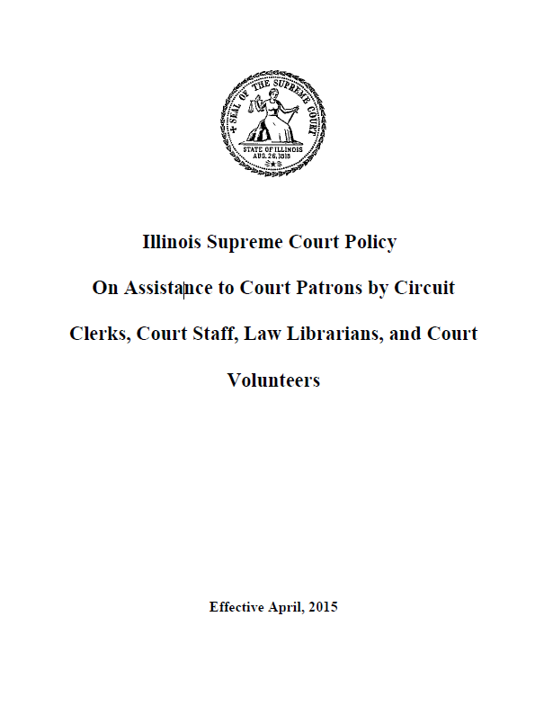
"Safe Harbor" Policy
Policy outlines "what services may and may not be offered to assist court patrons to achieve fair and efficient resolution of their cases."
"Services provided in accordance with section (d) of this policy do not constitute the unauthorized practice of law." (emphasis added)

Slide 15
Legal Information and Advice: What's the Difference?
Legal Information
Signals: Who, when, where, how?
Objective information - Shouldn't require details about case
Legal Advice
Signals: Should, what?
Subjective information - Often requires details of the case
Facts about the law and the legal process
Advice about the course of action a patron should take to further his or her own interests

Slide 16
Scenario #1
A self-represented litigant comes to your office. She would like to file a complaint and does not know how to serve the defendant. She asks "what should I do?"
How do you answer?
What information do you give her?

Slide 17
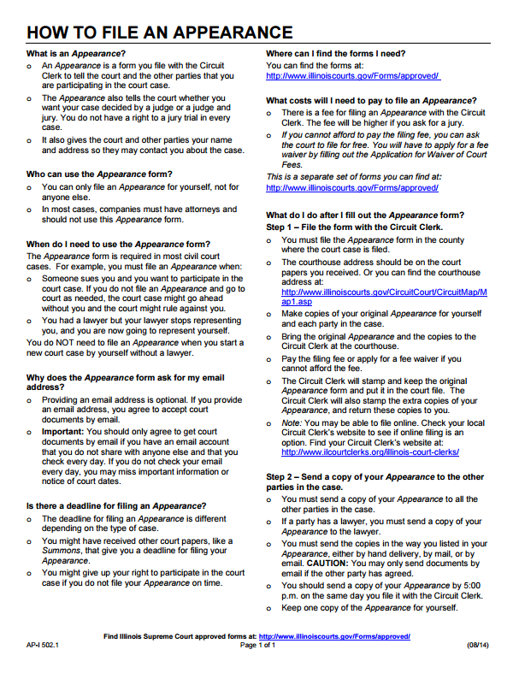
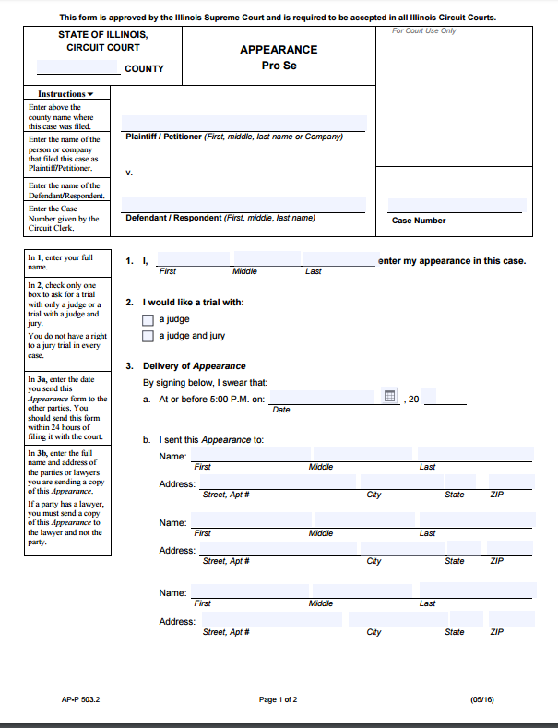
Illinois Supreme Court Forms
Each approved form is:
Created by a committee of judges, clerks, legal aid attorneys, and private bar attorneys
Accepted in every courthouse throughout the state pursuant to Supreme Court Rules 10-101
Translated into six language (Spanish, Polish, Russian, Arabic, Korean, and Mandarin Chinese)
Available as a PDF on the AOIC website:
http://www.illinoiscourts.gov/Forms/approved/
Available as a guided interview on ILAO:
http://www.illinoislegalaid.org/

Slide 18
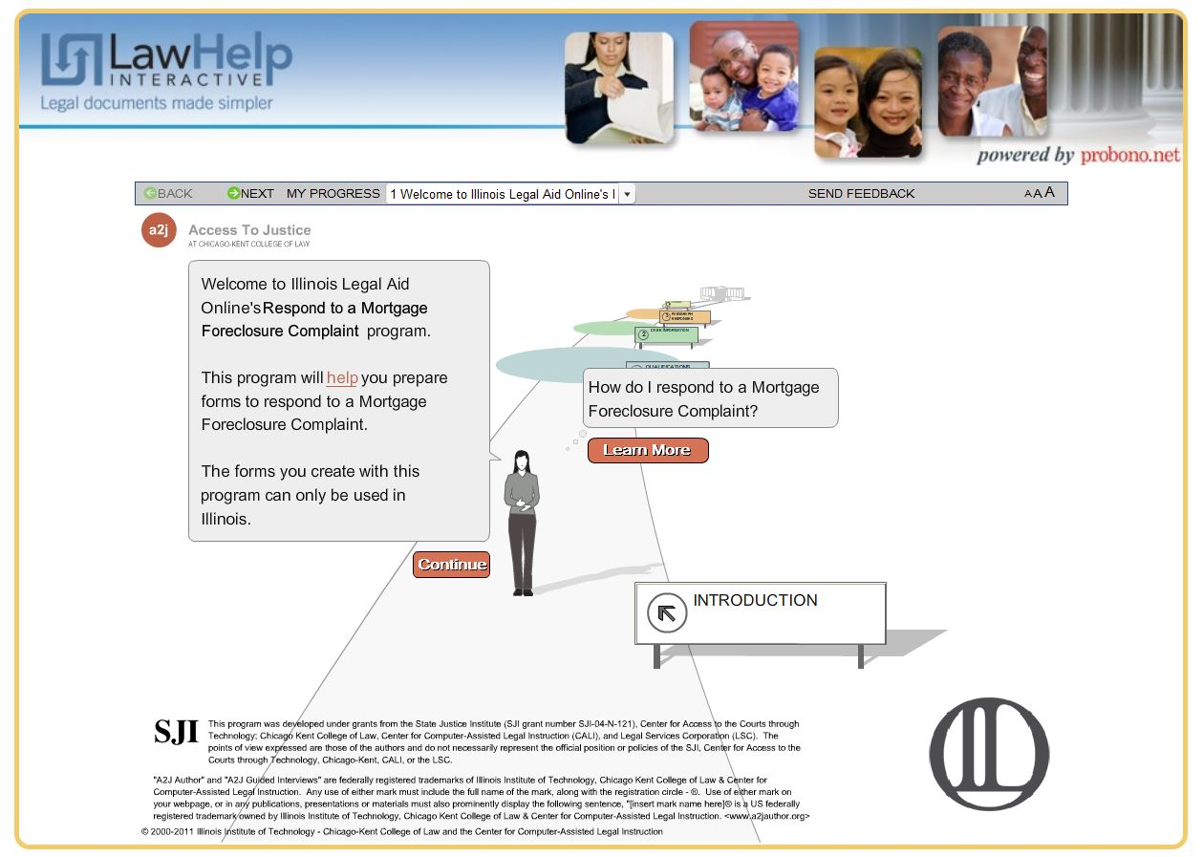
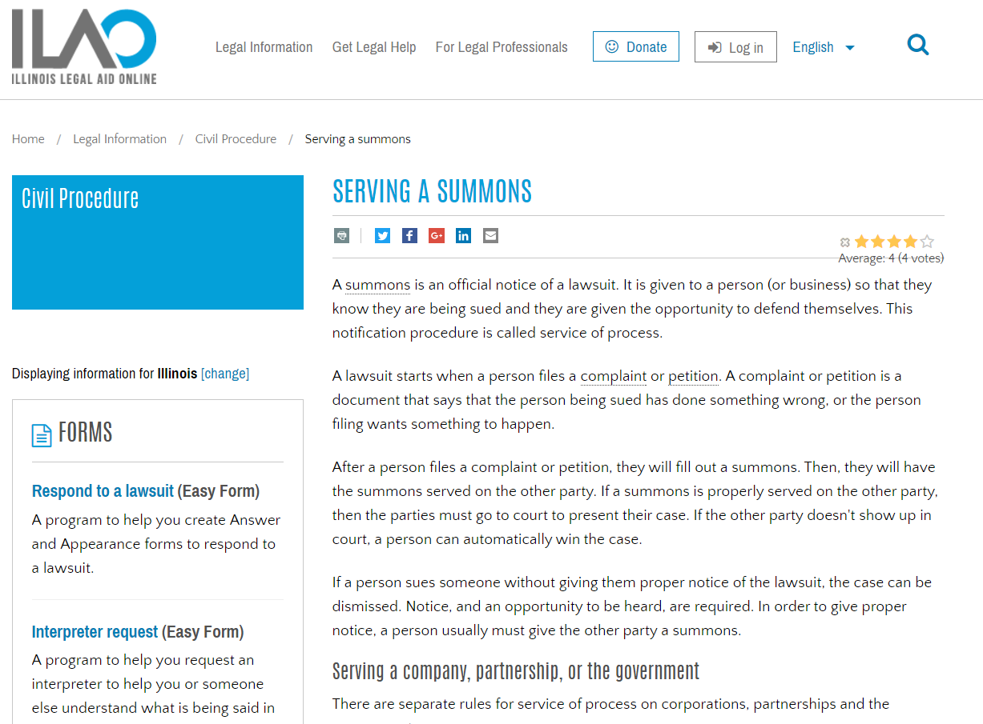
Illinois Legal Aid Online

Slide 19
Scenario #2
A SRL comes into the clerk's office and is visibly upset. His hearing was at 10:00 AM, and he thought it was at 1:00 PM. He's already missed the court call and a default judgment has been entered against him.
What do you say to him?
Do you explain what a default judgment is?
Do you advise him that he can file a motion to reinstate his case?

Slide 20
Scenario #3
An SRL in your office does not speak or read English. You do not have an interpreter available in your courthouse to assist.
How can your office best assist the SRL?

Slide 21
Language Access Resources
Supreme Court Language Access Policy: The Supreme Court outlines the state's commitment to language access. http://www.illinoiscourts.gov/CivilJustice/LanguageAccess/Language_Access_Policy.pdf
Language Access Plans: Every Judicial Circuit is required to have its own language access plan.
http://www.illinoiscourts.gov/CivilJustice/LanguageAccess/Language-Access-Plans.asp
Interpreter Registry: The AOIC maintains a database of certified interpreters.
http://www.illinoiscourts.gov/CivilJustice/LanguageAccess/Interpreter_Registry.asp

Slide 22
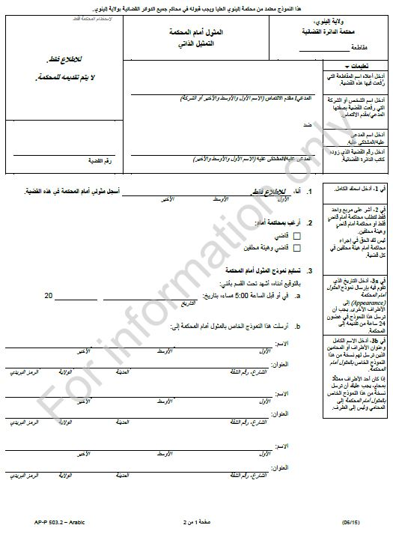

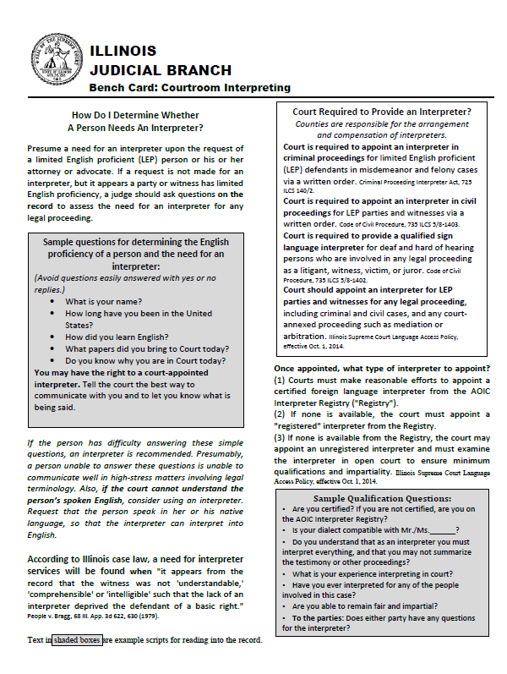
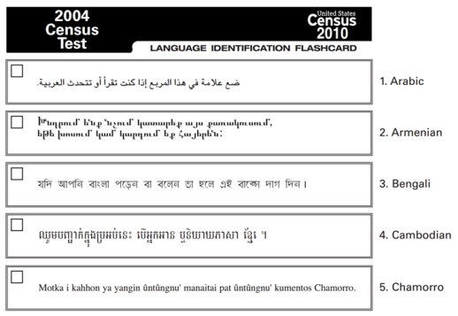
Additional Resources

Slide 23
Scenario #4
An SRL comes to your office to file a motion. You can see that she that she did not complete the entire form.
Do you tell her that she is missing information?
Do you file the pleading as she prepared it?

Slide 24
Scenario #5
An SRL comes to your office to file a motion. You can see that she filled out the wrong form.
Do you redirect her to the correct form?
Do you file the pleading as she prepared it?
What can you do to prevent this from happening?

Slide 25
Scenario #6
An SRL says she is a victim of domestic violence and needs help getting an Order of Protection. She asks you to help her fill out her paperwork because she is anxious and scared.
You want to help her, but should you?
Are there any resources you can share with her?

Slide 26
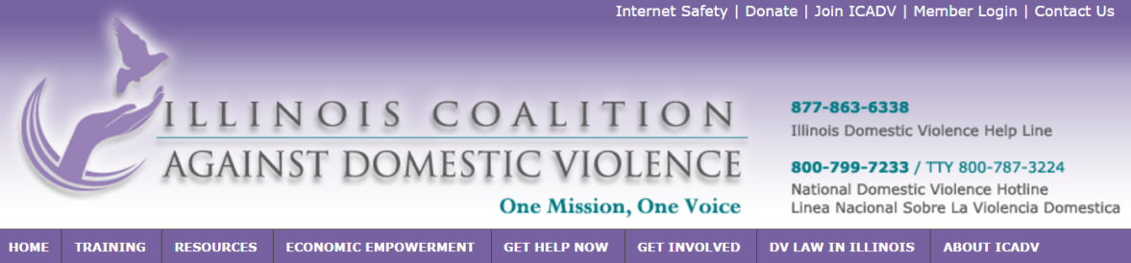

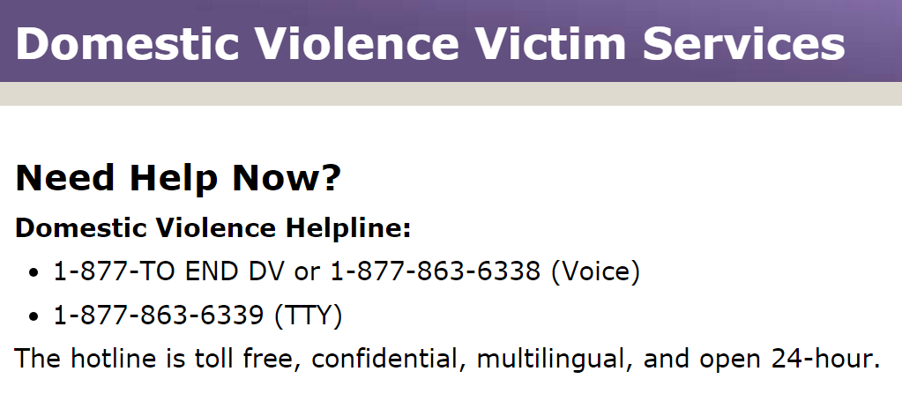
Domestic Violence Exception
The Illinois Domestic Violence Act at 750 ILCS 60/202(d) authorizes an exception to the general rule:
(d) Pro se petitions. The court shall provide, through the office of the clerk of the court, simplified forms and clerical assistance to help with the writing and filing of a petition under this Section by any person not represented by counsel.

Slide 27
Scenario #7
You encounter an SRL with her arm in a cast. She asks for help filling out her paperwork because she cannot write.
What do you do?
What if the litigant did not have a cast, but was unable to read or write due to low literacy? Would your answer be different?

Slide 28
A Note on Litigants with Disabilities
What is a disability?
When does someone need an accommodation?
A physical or mental impairment that substantially limits a major life activity
"Do you need assistance because of a disability?"
What is a reasonable accommodation?
A modifications designed to enable full access for an individual with a disability
"Fundamental alterations" are not reasonable
Don't make assumptions or ask about the type of the disability
Many disabilities are "invisible"
Notes:
With respect to the slides below, they look good as a general overview. On point I would add to the first slide, is that the judge in each case determines whether an accommodation request is reasonable. You can either add this to the slide, or just make the point aloud. This is important because the role of the Court Disability Coordinator is one of a liaison, with the judge being the ultimate decision maker for his/her courtroom.

Slide 29
Additional Guidance WITH ADA Issues
Additional Resources
Supreme Court Policy on Access for Persons with Disabilities
Local Court Disability Coordinator
IL Attorney General's Office – Disability Rights Bureau
Chicago Technical Assistance: 312-814-5684
Springfield Technical Assistance: 217-524-2660

Slide 30
Scenario #8
An SRL is filing a Notice of Appeal and tells you that he had to borrow money to pay the court fees, but he thought the issue was too important to ignore. He asks you where he can find more information about appeals.
Do you tell him to apply for a fee waiver?
Where would you send him for information?

Slide 31
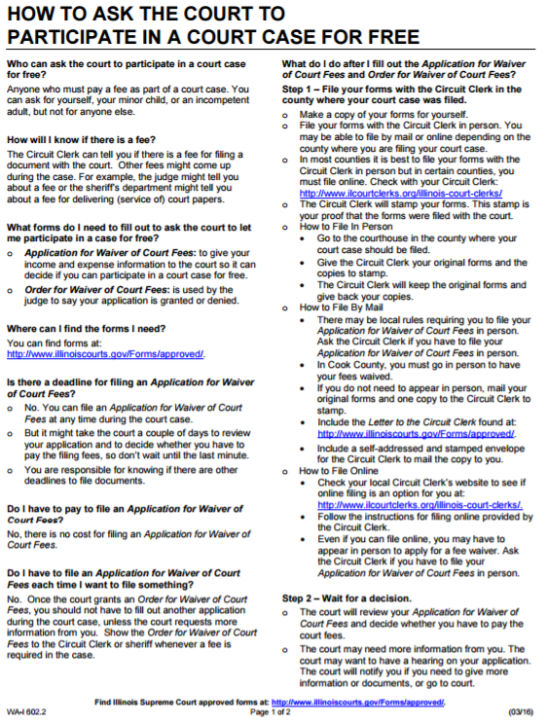
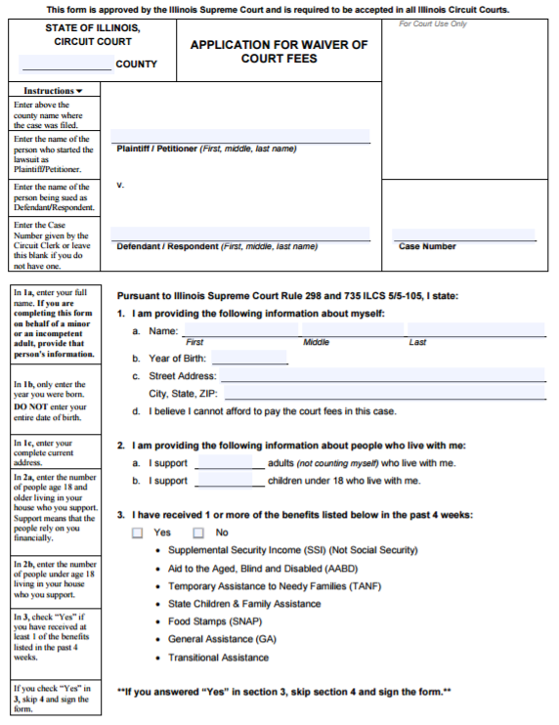
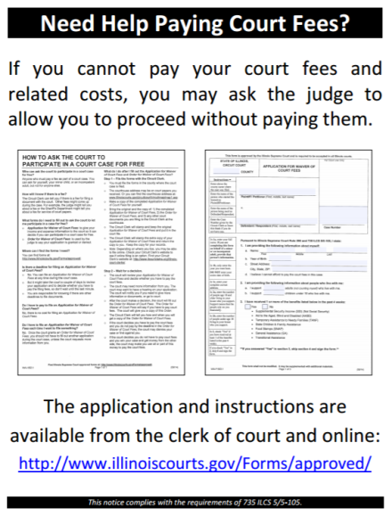
Fee Waivers

Slide 32
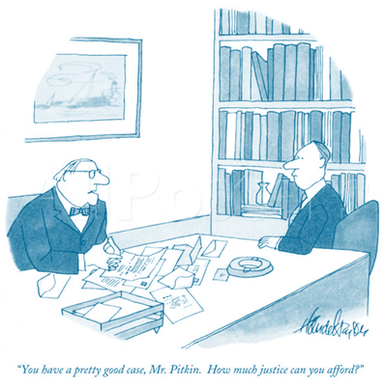
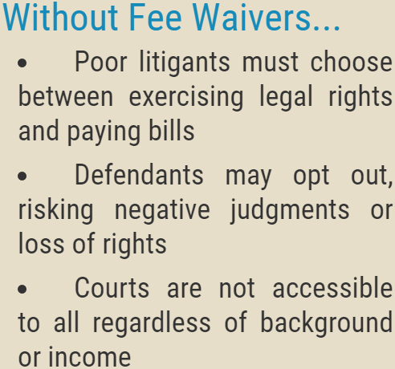
Why Are Fee Waivers Necessary?

Slide 33
Legal Advice v. Legal Information
Legal Information (Permitted) | Legal Advice (Prohibited)
Legal definitions | Legal explanations
Procedural definitions | Procedural advice
Available options | Recommended options
General attorney referral information | Specific referrals to private attorneys
Forms | Completed forms
Instructions on what to write | Advice on what to write
Court rules and protocol | Court strategy
Checking forms for completeness | Checking forms for accuracy
Local legal aid and self-help resources | Representation in court
How do I…? | Should I…?

Slide 34
Scenario #9
After an extended interaction with an SRL, you realize that the individual needs more than legal information. This individual needs legal advice and possibly an attorney to represent him.
Do you encourage him to consult with an attorney?
What referral information, if any, do you give?
What if he can't afford a private attorney?

Slide 35
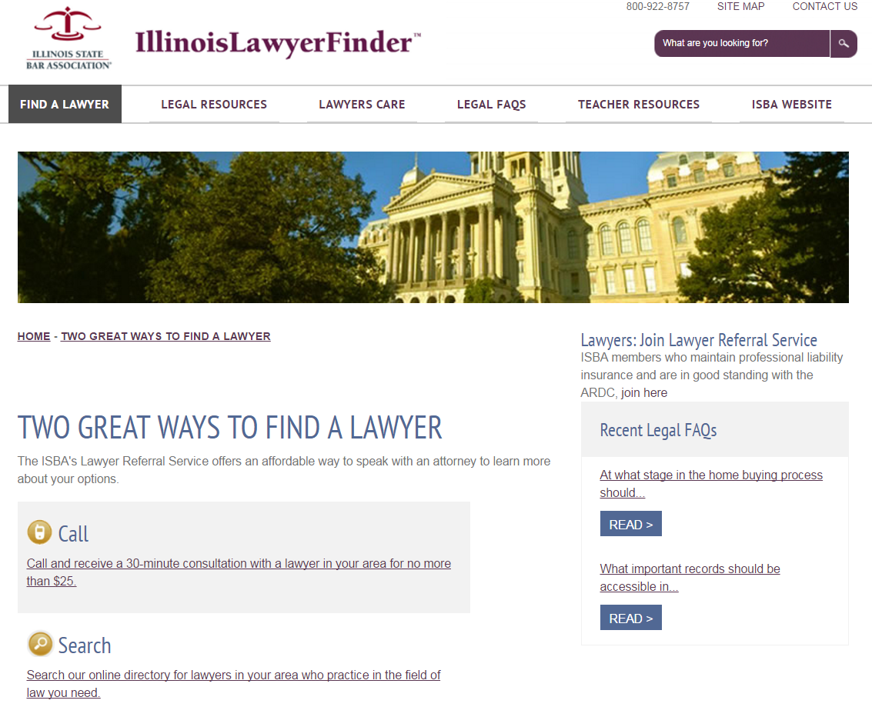
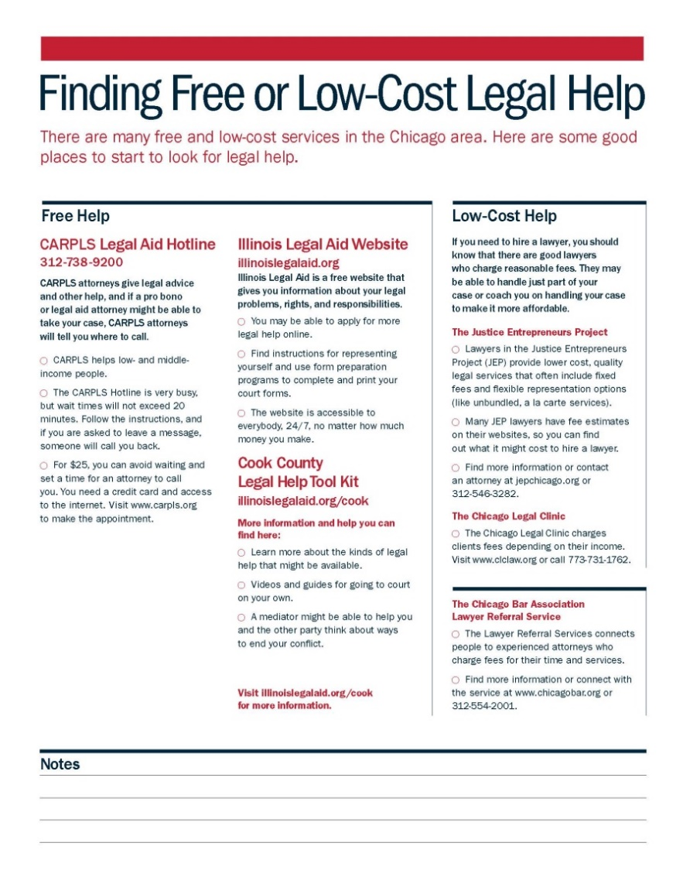
Lawyer Referral Services

Slide 36
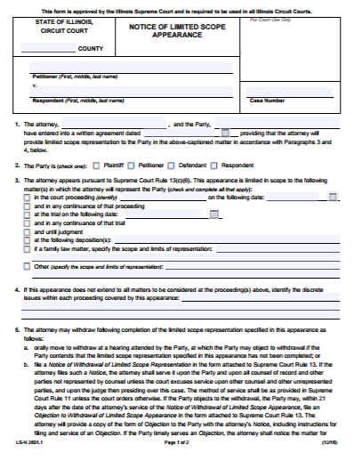
Limited Scope Representation
Legal problem
Income too high for legal aid/pro bono
Income too low for private attorney
"Unbundled" legal services
IRPC Rule 1.2(c)
Notes:
The Illinois Rules of Professional Conduct now allow lawyers to "limit the scope of representation" with informed client consent.
Legal problems happen to everyone regardless of income. Limited scope allows modest means litigants to hire an attorney for the most complex or most important portion of their case while handling the rest themselves.

Slide 37
Court-bAsed resources for SRLs
E-Filing
Standardized Forms
Fee Waivers
Language Access
Court Disability Coordinators
User-Friendly Signs
Safe Harbor Policy
Self-Help Guides
Remote Appearances
Legal Self-Help Centers
Law Libraries
Illinois JusticeCorps
Pro Bono Programs
Help Desks
Limited Scope Representation
Mediation/Arbitration
Public Access Computers
Interpreters
Notes:
Many resources have been created by the courts, AOIC, ATJ Commission, legal aid agencies, and other stakeholders to aid SRLs. These resources vary from courthouse to courthouse.

Slide 38





Community resources for SRLs
Legal Aid Agencies
Pro Bono Attorneys
Bar Associations
Law School Clinics
Social Service Providers
Domestic Violence Advocates
Public Libraries
Illinois Legal Aid Online
CARPLS (Cook County Only)
Notes:
These resources exist in the community to help SRLs by offering information and advice. These are highly localized and vary greatly from county to county.

Slide 39
Resource limitations
Private attorneys cost money
Legal aid and pro bono attorneys have limited capacity
Growing "legal deserts" without enough attorneys
Lack of awareness of existing resources
Self-help resources may be too sophisticated
Self-help resources don't cover every case type
Distance from court
Distance from legal aid and social service providers
Physical and mental disabilities
Language barrier
Notes:
All of these resources are no enough to address the justice gap. More need to be done and technology and ODR/ADR can play a role.

Slide 40
Making Strong Referrals
Be specific
Avoid jargon
Set expectations
Write it down

Slide 41
Thank You!
Samira A. Nazem
Self-Represented Litigant Services Specialist
Administrative Office of the Illinois Courts
(312) 793-2305
snazem@illinoiscourts.gov

